Slide 1


Car Accidents
Lior turgeman 304941412
Dan avERIN 204358394

Slide 2
Project Overview and Research Question
Is there a connection between the amount of car accidents to the weather conditions occurred at the time of the accident?
Is there a connection between the weather and the type of accidents happened (In intersection, what type of Objects were harmful in the collision…)
Is it possible To predict which accidents will happened according to the road type?
Is there a connection between car accidents and the time/day/night conditions?
Are there states in which more car accidents are likely to occur?

Slide 3
מקורות מידע API הרכשה אם עשינו+ לינקים\
API & Sources
We chose to use information from NHTSA(National Highway Traffic Safety Administration) - agency of the U.S. federal government, part of the Department of Transportation.
https://crashviewer.nhtsa.dot.gov/CrashAPI
We used the API to retrieve CSV data files from years 2010 up to 2019.

Slide 4
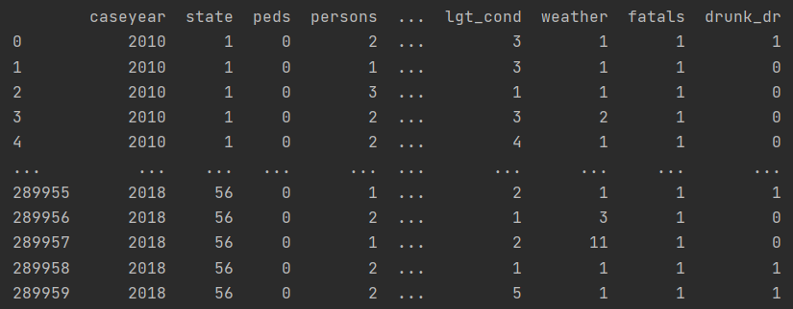
Data Handling and Cleaning
- In our project we used data from the years 2010 up to 2019.
- Each year had close to 35,000 records, eventually we got around 290,000 records as result of 10 years of car accidents data from the USA.
- We emitted irrelevant data from the original csv files, combined all data to one file which will be used to research the question we presented.

Slide 5
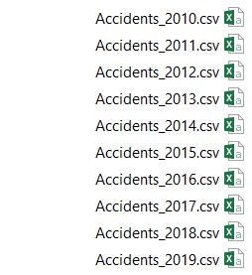
API
The API we got from https://crashviewer.nhtsa.dot.gov/CrashAPI we got a lot of information.
There is a lot of API options, and we chose to Get FARS Data By Year with the richest variety of information.
The data pulled using the following API requests:
https://crashviewer.nhtsa.dot.gov/CrashAPI/FARSData/GetFARSData?dataset=Accident&caseYear=X&format=csv
X – represents every year from 2010 up to 2019
We combined and created new big CSV File with all the data that contains
323,480 rows of data.

Slide 6
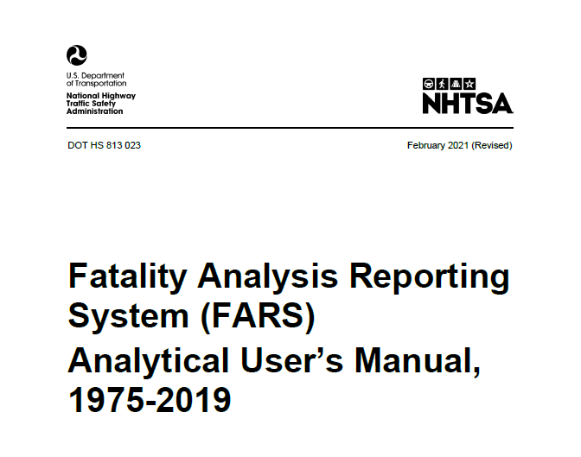
EDA
While we check our Data we cleared not Relevant Data to our research questions.
FARS provides PDF File with information regarding each column, under the filename:
“Fatality Analysis Reporting System (FARS) Analytical User’s Manual,
1975-2019.PDF”
The file is attached in the project under csv_files folder.
We defined a List with all irrelevant columns to be removed from The CSV data files, According to the PDF file.

Slide 7
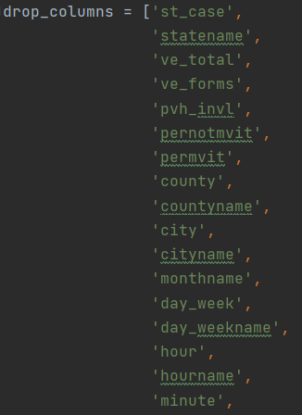
EDA
Almost any column appears twice, First column as Text, Second time as Nominal number.
For getting more reliable data we cleared from every column Unknown Values.
Columns with irrelevant data for our research question
For example:
Reason omitted | PDF Column explanation
File consecutive number
Our research question does not refers to forms.

Slide 8
מסקנות לאחר ניקוי המידע הוצאה של גרפים – מסקנות
Graphs

Slide 9
למידת מכונה מסקנות ואיך לבצע

Slide 10
TEXT

Slide 11
TEXT

Slide 12
TEXT

Slide 13
TEXT

Slide 14
TEXT

Slide 15
TEXT

Slide 16
TEXT

Slide 17
TEXT

Slide 18
TEXT

